Slide 1
Pre-processing in Machine Learning
Jake Marshall &
Pragya Paudyal
Data Science Lecturers
Notes:
This session will be a brief reminder of the day and intro to Modular Programming concepts.

Slide 2
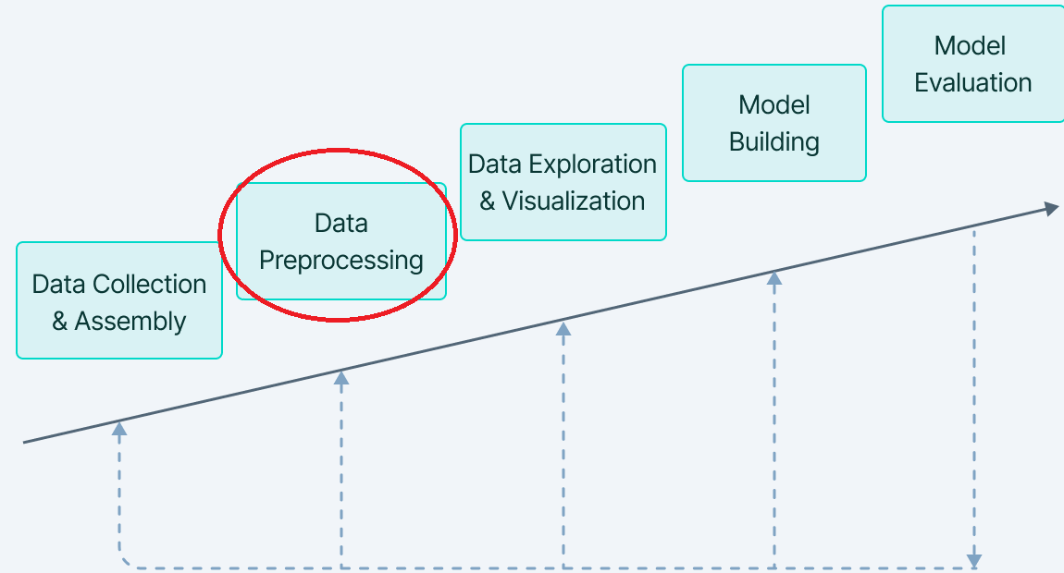
Machine Learning Stages

Slide 3

Slido
We will start with some slido discussion.
Thumbs up questions you would like answered.
Slido - slido.com with #DSGP

Slide 4

What do you think?
Data Scientists spend what percentage of their time in data pre-processing?

Slide 5

A Time-Consuming Task
60- 80% of our time is usually spent on pre-processing.
Most time-consuming task in ML.
Will be returned to many times throughout the workflow.

Slide 6

Back to you!
What is Pre-processing?

Slide 7
Pre-processing
Preparing and cleaning the data before it can be used for training a machine learning model.
Garbage in Garbage Out
Good data preparation can lead to better performance out of any model.
Bad data preparation can lead to bad performance

Slide 8

One more question for you!
Why do we need to pre-process our data?

Slide 9
Why do we need Pre-processing?
Data quality
Raw data are messy, and it can affect the accuracy and reliability of the model
Data compatibility
Different format, structure and scale, which can make it difficult to compare and combine

Slide 10
More reasons
Dimensionality Reduction
Too many features can sometimes reduce model performance
Interpretability
Pre-processing helps to transform the data into a more interpretable format, making it easier to understand the patterns and relationship between variables

Slide 11
Data Cleaning
Real world data is messy as it contains lots of potentially incorrect data.
Involves
Treating missing values
Identify outliers and smooth out noisy data
Correct inconsistent data

Slide 12
Missing Values: Deletion
Delete rows or columns
If the number of missing value is small
If deleting the rows or column doesn’t significantly affect the representativeness of the data

Slide 13
Missing Values: Imputation
Imputation: Missing values are filled in with estimated values based on the available data.
Mean, median, regression
Imputation depends on type and distribution of the data
Model-based imputation by using machine learning algorithms to estimate missing values.
K-Nearest Neighbor

Slide 14
Missing Values: Interpolation
Interpolation: Missing values are filled in with values that lie between the surrounding points.
Pad - fills in the missing values with the previous value going down the column. (Useful for when the order of the data matters i.e. time series data)
Linear - fills in the missing values using a linear function between the point before and the point after the missing value.

Slide 15
Noisy Data: Check data types
Important step to ensure each variable is of the correct data type such as float, object, integer etc.
Convert variable type if required.
Ensures that our data is in format that machine learning algorithm can process effectively.

Slide 16
Noisy Data
Binning
Sort data and partition into equal frequency bins
Clustering
Detect and remove outlier
Regression
Smooth by fitting the data into regression function

Slide 17

Data Transformation
Process of converting the data into format or structure suitable for model building.

Slide 18
Feature Encoding (Categorical Data)
It is process of converting categorical variable into numerical variable so that they can be used as input to machine learning algorithms.
Most machine learning algorithms can handle only numerical features.
Each unique category in the categorical variable is mapped to a numerical value.

Slide 19
One-Hot Encoding (dummy encoding)
This creates a new binary column for each unique category in the original dataset.
Food Name
Apple
Chicken
Broccoli
Apple | Chicken | Broccoli
1 | 0 | 0
0 | 1 | 0
0 | 0 | 1

Slide 20
Feature Encoding : Label Encoding
This assigns each unique category in the categorical variable a numerical value, but numerical values do not have any inherent ordering or meaning.
Food Name
Apple
Chicken
Broccoli
Food Name
1
2
3

Slide 21
Feature Decoding (Numerical Data)
Whilst categorical data can be encoded, numerical features can be decoded into categories.
Discretization
Binarization

Slide 22
Feature Decoding: Discretization
Purpose of this approach is to transform a continuous variable into a discrete one.
This divides a continuous feature into a pre-specified number of categories (bins).
These bins take the form of intervals that span the entire range of values the variable can take.

Slide 23
Feature Decoding: Binarization
Useful as a feature engineering technique for creating new features that indicate something meaningful.
Process of thresholding numerical features to get Boolean values.
Usually done using conditional statements and hence converted to Binary values 0 and 1.

Slide 24
Data Transformation: Feature Scaling
Variables in real world datasets vary in degree of magnitude, range and units.
With varying scales, some features may dominate the others, negatively impacting the predictions the model generates.
For machine learning models to interpret these features on the same scale, feature scaling is necessary.

Slide 25
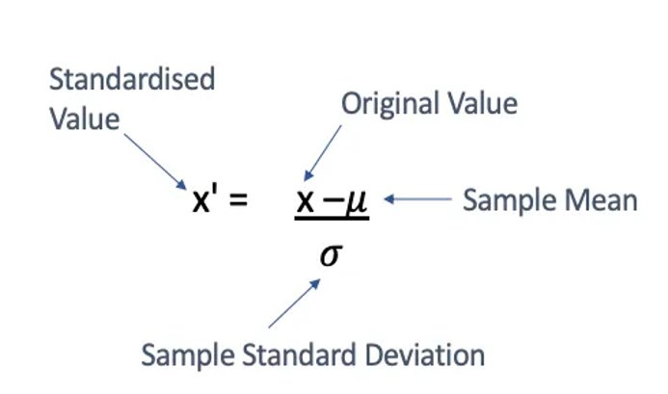
Standardisation or z-score
Helps to scale down feature based on standard normal distribution.
Standard normal distribution has mean of 0 and standard deviation of 1.

Slide 26
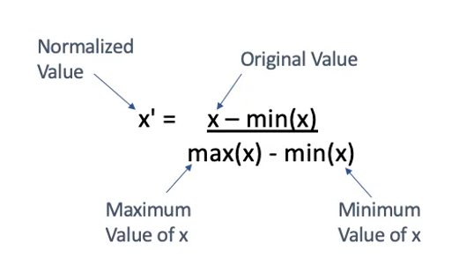
Normalisation/Min-Max Scaling
Helps to scale down features between 0 to 1
Subtracts the minimum value and divides by the range (difference between max and min).

Slide 27
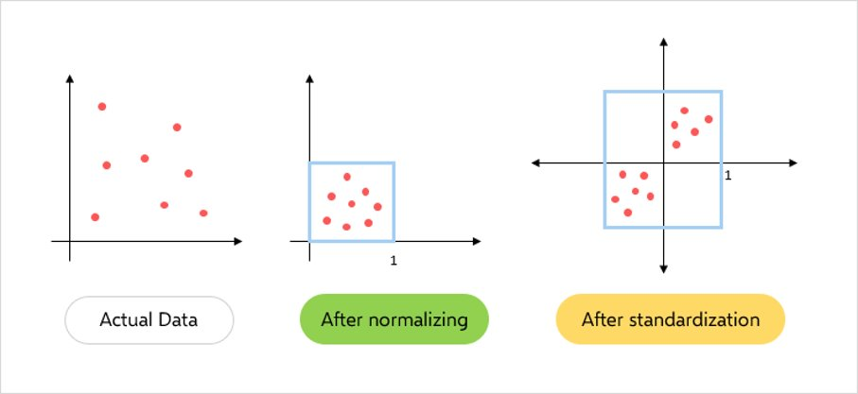
Feature Scaling: Normalize vs Standardize

Slide 28
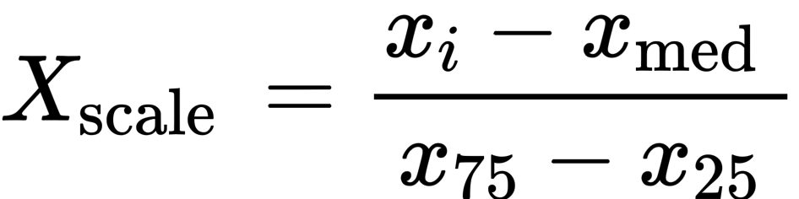
Robust Scaling
Helps to scale down feature like with standardization.
However, it uses statistics that are robust to outliers!
Process subtracts the median and divides by the inter-quartile range.

Slide 29
Which algorithms require scaling?
Algorithm | Reasons for scaling
K-Means Clustering | Uses Euclidean Distance measure
K-Nearest Neighbours | Measures the distance between pairs of samples – impacted by units.
Principal Component Analysis (PCA) | Ensures we retain as much information as possible

Slide 30
Algorithms less impacted by scaling?
Feature scaling is not required for algorithms that aren’t distance based, such as:
Naive Bayes
Linear Discriminant Analysis
Tree-Based models (decision trees, gradient boosting, random forests)

Slide 31
Normalisation or Standardisation/Robust?
No definitive answer as it highly depends on the data and the context of the problem.
Normalisation is extremely sensitive to outliers, which would invite robust scaling as the preferred method,
Normalization is very useful when you are unsure of the distribution of the data or are certain it is not normally distributed.

Slide 32
When to scale the data
In general, feature scaling should be done after dataset splitting to avoid data leakage.
If we scale before the split, then the testing data is not independent of the training data, which could lead to over-exaggerated good performance.
When it comes to perform on truly unseen data, it may be worse than expected.

Slide 33
Data Reduction
Reduce the size of a dataset while retaining as much of the relevant information as possible.
Helps model accuracy, interpretability, and speed of computation.
Helps reduce overfitting by filtering out noise.
Reduces computational cost.

Slide 34
Feature Selection
Selecting a subset of the original features which are most relevant to the prediction of the target variable.
Identify the features that are most relevant to the problem while discarding those that are irrelevant or redundant.
Analysis of this starts during Exploratory Data Analysis (EDA) with visualisations of one feature vs. another (or features vs. the target).

Slide 35
Feature Selection Methods
Embedded Method
Performs feature selection as part of the model training process
Filter Method
Evaluating the relevance of each feature based on their statistical properties.
Wrapper Method
Evaluating the performance of the model using subsets of features.

Slide 36
Feature Selection
Embedded Method
Filter Method
Wrapper Method
ANOVA
Variance thresholding
Feature
importance
Forward
selection
Stepwise
selection
Lasso
regression
Ridge regression
Pearson’s correlation
Backward
selection

Slide 37
Dimensionality Reduction
Transforming the original dataset (multi-dimensional) into a lower-dimensional sub-space.
Identify a new set of features that capture the essential characteristics of the original data while reducing the overall dimensionality.
Principal component analysis (PCA), singular value decomposition (SVD) , t-distributed stochastic neighbour embedding (t-SNE) are some of the most common techniques.

Slide 38
Dimensionality Reduction: PCA
Works by transforming the original variable into a new set of variables called principal components.
Powerful approach for reducing the complexity of high-dimensional dataset.
Helps to improve the performance of machine learning models by reducing the risk of overfitting.

Slide 39
Data Partitioning
Dividing the data into training and testing sets to evaluate the performance of the model.
Training dataset
Used to train the ML model.
Test dataset
Used to evaluate the final performance of the model, after it has been trained.

Slide 40
Data Partition
Shuffle the data to ensure that the training and test sets are representative of the overall dataset.
Split data into 2 subsets.
80-20 is the common split where 80% is training and 20% testing.

Slide 41
Data Pre-processing
Data
Cleaning
Data Transformations
Data Reduction
Data Partition
Missing value
Test
Encoding
Feature Scaling
Dimensionality Reduction
Feature
selection
Train
Noisy data
Data Type
Label Encoding
/One-Hot Encoding
Binarization/
Discretization
Normalization
Standardization

Slide 42


